Slide 1
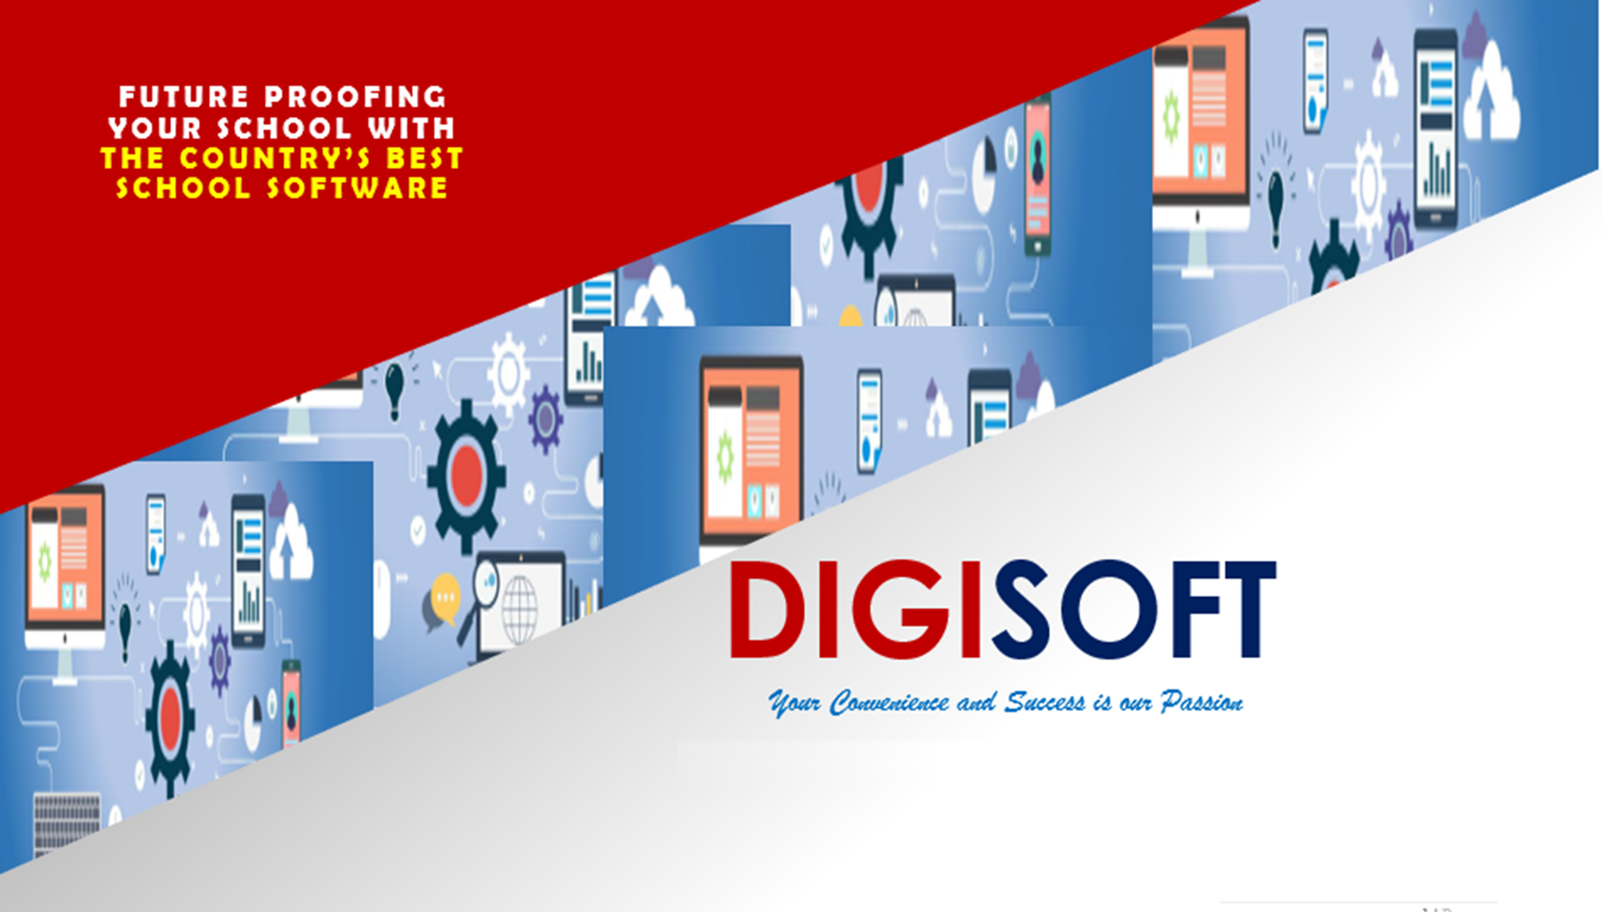

Slide 2
HISTORY
1991: Wrote my first programs
1994: Grading System
1996: Computer-Aided Examination System
1997: Payroll System, Sales and Accounts Receivable Systems
1998: Student Information Systems (SIS) 1.x
2003: Student Information and Accounting Systems (SIAS) 2.x
January 18, 2004:
Digital Software Technology Consultancy
2023:
Digital Software Corporation

Slide 3
The evolution of SIAS Online 3.x
1998: SIS 1.x: LAN-based, CUSTOMIZED System
Implemented at St. Paul University Philippines (SPUP)
After 25 years, SPUP is still our client today
2003: SIAS 2.x: VFP 9.0, UNIFIED System
Implemented at Kalinga State University (KSU)
After 20 years, KSU is still our client today
Used by 100+ schools nationwide
2014: SIAS Online 3.x: UNIFIED System for SUCs / Private
Upgraded many old existing clients to the cloud (1-day upgrade)
FREE cloud server offered to all clients
2018: SIAS Online 3.3: UNIFIED System for SUCs / Private / DEPED
Added support for DEPED specific operations
Added support for Senior High School
Added integrated Learning Management System

Slide 4
SIAS Online 3.x in year 2023
The MOST ADVANCED, MOST COMPLETE and FULLY INTEGRATED
School Software in the Philippines!
The FIRST and ONLY school software with INTEGRATED Learning Management System (LMS) in the Philippines.
- Moodle:
- Google Classroom:
- Microsoft Teams:
- NeoLMS:
- Schoology:
- Canvas:
- Quipper:
- SIAS-LMS:
Australian
American
American
American
American
American
Japanese
Filipino
100% Gawang Pinoy

Slide 5
SIAS Online 3.x in year 2023
The ONLY school software in the Philippines that is
CONTINUOUSLY IMPROVED (Since 1998)
DOWNLOADABLE,
UPGRADEABLE
UNIFIED SYSTEM
The ONLY school software which is
100% Desktop and MOBILE friendly
(ALL User Interfaces: Admin, Trans, Tools & Reports)
5) No. 1 in SUCs
No. 1 in Private schools
No. 2 in DEPED after LIS
24 Years Cumulative Improvement
UNIFIED system for SUCs, Private and DEPED

Slide 6
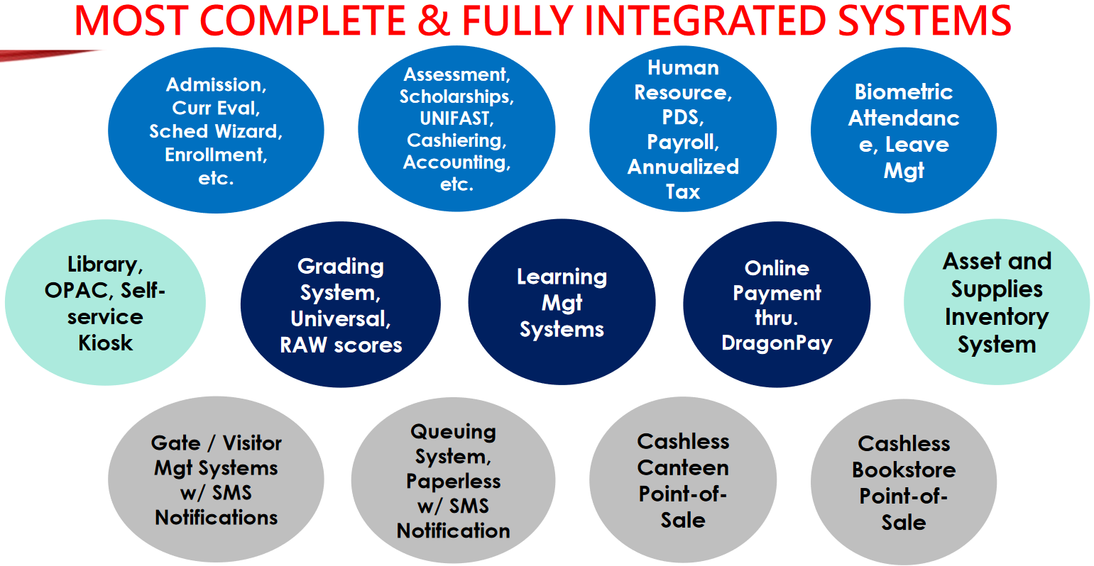

Slide 7

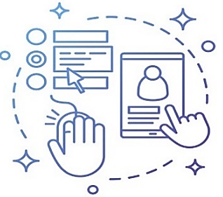



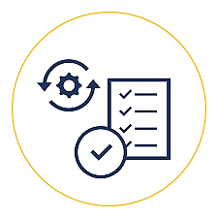





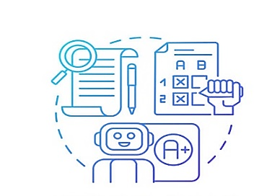


Student Life Cycle
ADMISSION
ENROLLMENT
Application
Student Profiling
Document Mgt
Auto ID No.
Subject Mgt
Curriculum Mgt
Curriculum Evaluation
Class Scheduling
REPORTS
ACCOUNTING
Masterlist
Grade Reports
Report Card/TOR
UNIFAST
DEPED/CHED Reports
etc
Assessment
Scholarship
Cashiering
Student Ledger
Online Payment
Resource Bank
Test Bank
Subject/Class Modules
Online Tasks (Quizzes, Exams, Assignments & Projects)
Online Meetings
Learner’s Proficiency Level
Test Item Analysis
SMS Notification
Class List
Grade Sheet
Periodic Avg Grade
Auto Compute GWA
GRADING SYSTEM
LEARNING MANAGEMENT SYSTEM (LMS)

Slide 8
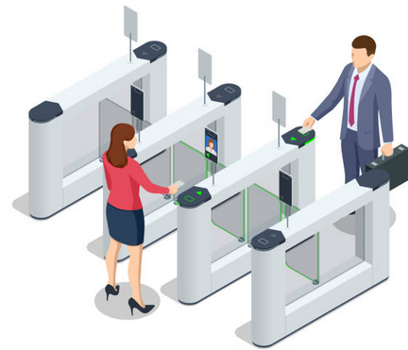



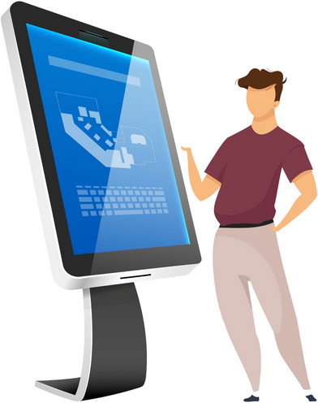

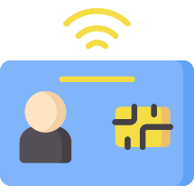


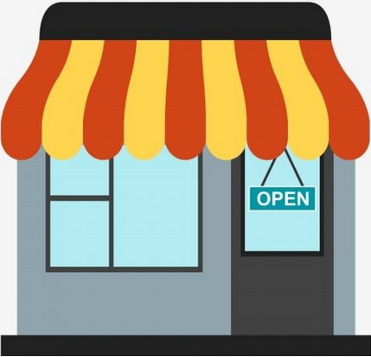

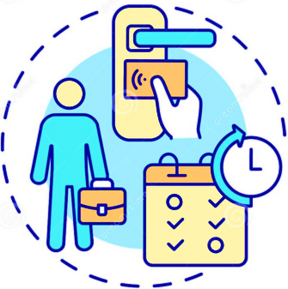


GATE ENTRY SYSTEM
LIBRARY
POINT-OF-SALE
UNIFIED ID SYSTEM
STUDENT INFO
KIOSK
COOP
CANTEEN
EMPLOYEE
IN & OUT
QUEING SYSTEM

Slide 9


UNIFIED Programming Model
LGU-CARES
CITIZEN CARD
HOSPITAL MANAGEMENT SYSTEMS
(80%)
BIOMETRIC AND PAYROLL SYSTEMS
UNIFIED Systems
SCHOOL MANAGEMENT SYSTEMS
ASSET
AND SUPPLIES
INVENTORY
LEARNING MANAGEMENT SYSTEM
(LMS)

Slide 10
WHY WE USE THE UNIFIED PROGRAMMING MODEL?
It is the International Standard
used by Microsoft, Google, Apple, Amazon, Oracle, etc.
Single Source Code Maintenance
Design is flexible (One system for all clients)
Data-driven and User-defined Customization
5) Upgradability even after 15+ years
6) Replicate ALL improvements to all clients

Slide 11
PRICING
State / Local Universities and Colleges:
SAAS (with or without LMS)
Private Universities and Colleges:
  College / Senior High: _____ per semester
  Elementary / Junior / Senior High: _____ per year
  Separate price for LMS
DEPED: FREE for Pilot Schools

Slide 12
AFTER-SALES SUPPORT
FREE Cloud Server
FREE Technical Support*
FREE Upgrades and Maintenance
FREE Database Backup (Downloadable)
Continuous Updates (At least 3x per week)
* Transportation, Lodging and Meals shouldered by clients

Slide 13
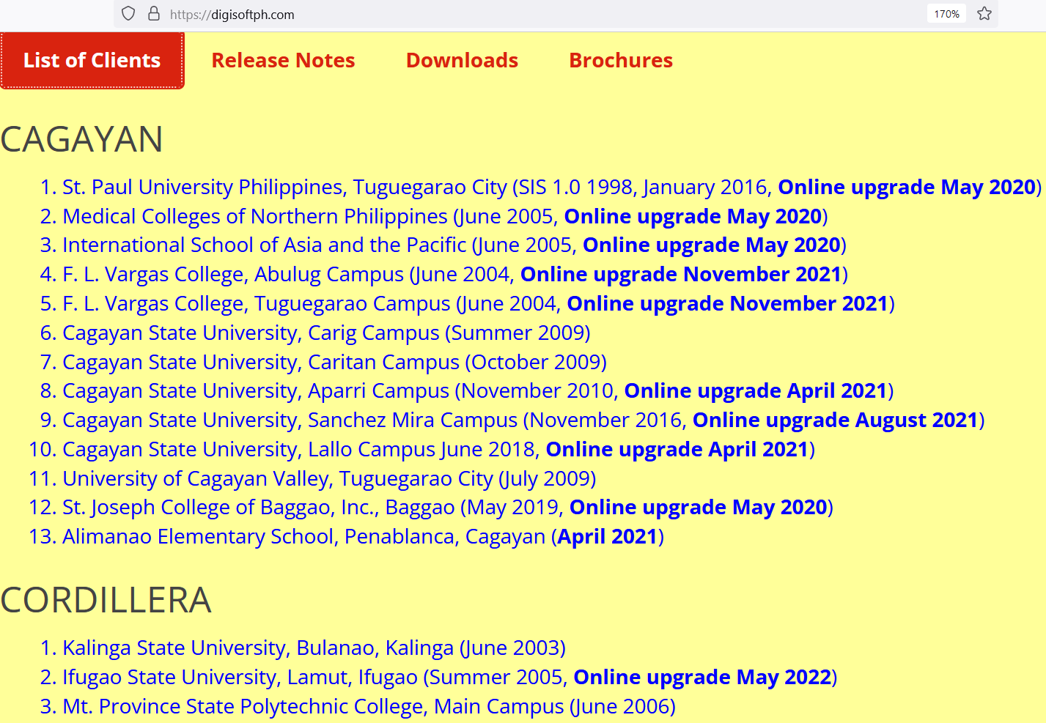
List of Clients as of 2022

Slide 14
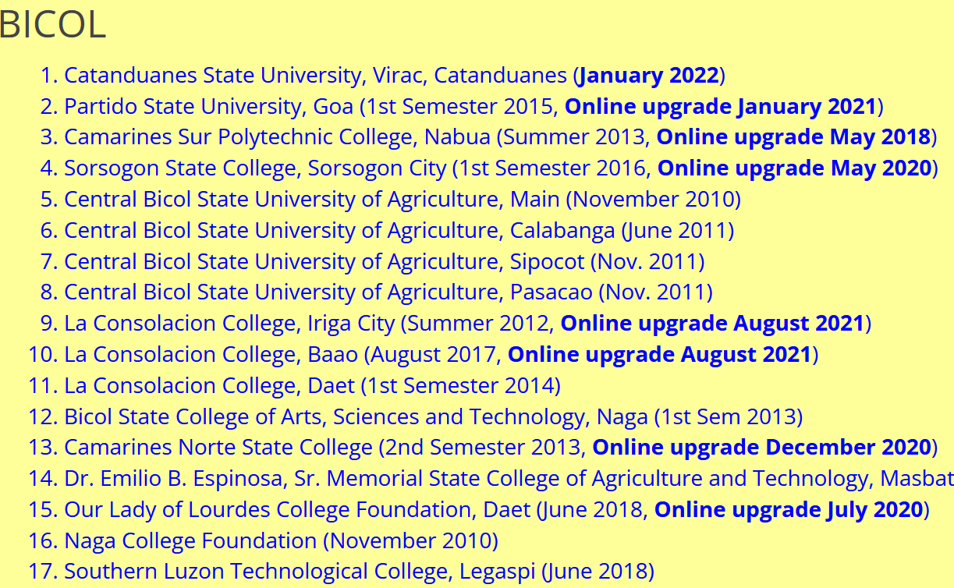

Slide 15
WHY WE PUT DATES ON OUR LIST OF CLIENTS?
Most trusted school software in the Philippines
Longest life span (10 to 25 years)
Excellent Retention rate (97%)
Upgradability even after so many years
5) We don’t hide our List of Clients

Slide 16







UNMATCHED SPEED AND PERFORMANCE
Client
Server
Client
Server
Give me
5
Ok, here is your PAGE with a 5 inside
Give me
5
Ok, here is your 5
5

Slide 17
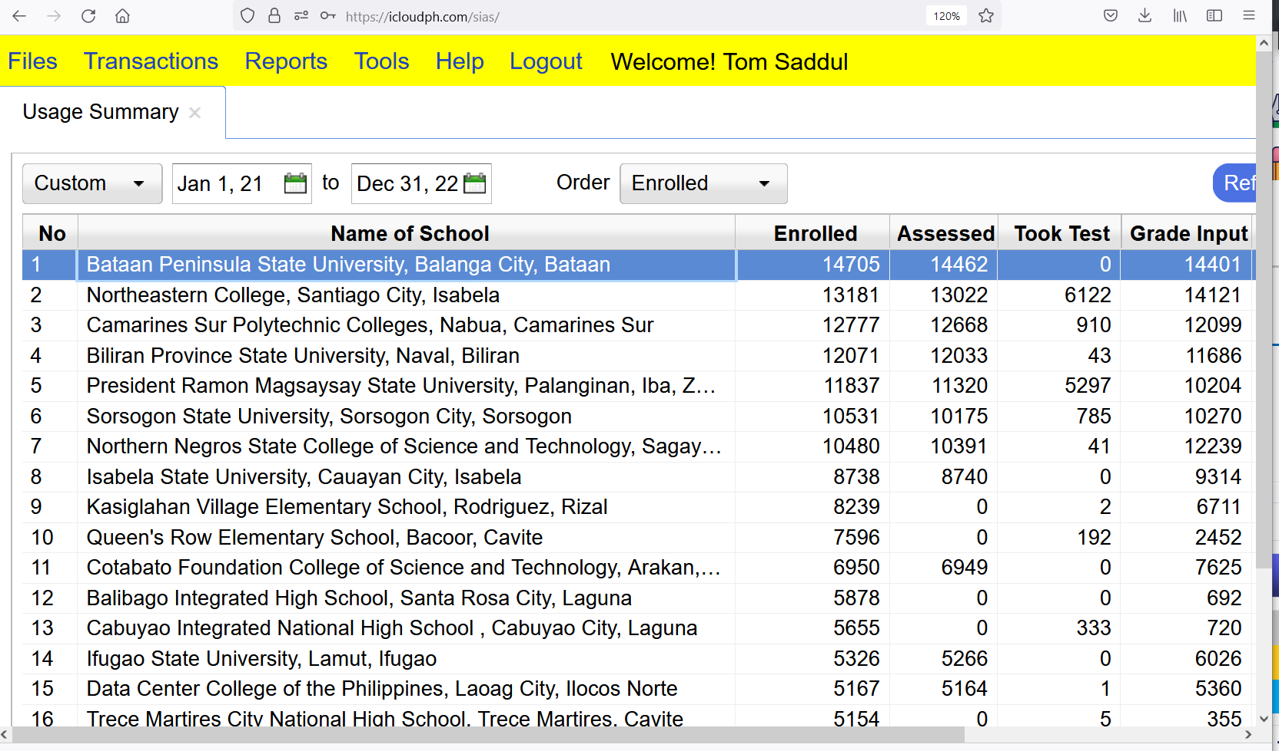
MINIMAL SERVER REQUIREMENTS AS OF 2022:
20-vcore shared server can efficiently serve 200k plus students

Slide 18

SERVER-SIDE UI TECHNOLOGY (OBSOLETE)
(used by Pinnacle, Data Pacific, GTI, etc)
Server
Generates HTML PAGE
Generates PDF / Excel
90% to 100% workload
Heavy & slow HTML PAGE reply which require the browser to reload the page
Client
Client
Client
Client
Frequent browser reload
0% to 10% workload (wasted clients processing power)
15+ years obsolete (was popular pre-2005)

Slide 19
100% CLIENT-SIDE UI TECHNOLOGY
(used by Digital Software)
Server
0% to 10% workload
Web API-Based Architecture
Lightweight & fast JSON DATA reply
Client
Client
Client
Client
0% browser reload
100% client-side generation of PDF / Excel
90% to 100% workload
Maximizes usage of clients processing power
Latest technology
Support OFFLINE mode

Slide 20









UNIFIED
SCHOOL MANAGEMENT SYSTEMS
Backup
CENTRAL OFFICE
Tuguegarao
Manila
XYZ CAMPUSES
CLOUD SERVER
Bacolod
Batangas
DB
DB
IRIGA
DB
MANILA
BAAO
MALOLOS
BIÑAN
DAET
VALENZUELA
LILOAN
BACOLOD
Cebu
Japan
Legazpi
United States
Australia
Davao

